Slide 1
Unit 1 Chapter 1
TEN PRINCIPLES OF ECONOMICS

Slide 2
INTRODUCTION
Resources are limited or scarce
Scarcity: Suggests that society has limited resources and therefore cannot produce all the goods and services people wish to have
Economics is the study of how society manages its scarce resources
Decisions are made by the households, firms, and other players of an economy
Economics studies the decision making process of individuals, firms and others

Slide 3
INTRODUCTION
How people make decisions
Behaviour of the economy depends on the behaviour of the individuals or economic agents
How people interact
Our economic behaviour is associated with how we interact with people
How the economy works as a whole
Decisions and interactions together makeup the economy

Slide 4
1. People face trade-offs
To get something that we like, we have to give up something else as well that we like
Subjects for a student OR spending monthly income
Guns (defense) and butter (consumer necessities) trade-off
Climatic changes and industrial development
Efficiency v/s equality in policies
Efficiency: the property of society getting the most it can from its scarce resources
Equality: the property of distributing economic prosperity uniformly among the members of society

Slide 5
2. The cost of something is what you give up to get it
Making decisions requires comparing the costs and benefits of alternative courses of action
Opportunity cost: of an item is what you give up to get that item OR next best alternative
Often the opportunity cost is not apparent or measurable
IPL Final V/S exam next day morning?
Numerical example: 2 burgers OR 4 sandwiches in one hour time
Opportunity cost of burger is 2 sandwiches

Slide 6
3. Rational people think at the margin
Economic agents are expected and assumed to be rational
Rational people systematically and purposefully do the best they can to achieve their objectives, given the available opportunities
Rational people often make decisions by comparing marginal benefits and marginal costs
A rational action ensures the marginal benefit of the action exceeds the marginal cost
Diamond – Water paradox

Slide 7
4. People respond to incentives
An incentive is something that induces a person to act
Agents are rational, and hence respond to incentives
Agents are also consistent and they make the best choice available
Flipkart Big Billion sale
Mobile networks offering 1.5 GB per day
Increased demand for electric vehicles with rising fuel prices
Governments often reduce the interest rates to attract more investments

Slide 8
5. Trade can make everyone better off
Trade between two individuals can make them better off
Not all agents have the resources to meet their wants
Available resources may not be used efficiently
Trade allows each agent to specialize in the activities he/she does best
Recall the barter system
Countries trade each other because they are not self sufficient in all goods and services

Slide 9
6. Markets are a good way to organize economic activity
Market is a means (NOT A PLACE) by which the exchange of goods and services takes place between two parties
Market economy: an economy that allocates resources through the decentralized decisions of many firms and households as they interact in markets for goods and services
Guided by individual self-interest resulting in the economy’s well being
Adam Smith’s invisible hand – prices as instruments

Slide 10
7. Governments can sometimes improve market outcomes
Favourable institutional and legal environment needed
Property rights: the ability of an individual to own and exercise control over scarce resources
Market failure: a situation in which a market left on its own fails to allocate resources efficiently
Externality: the impact of one person’s actions on the well-being of a bystander
Market power: ability of a single economic agent (or a small group) to have a substantial influence on market prices
Laissez faire, 1930s and Keynesian theory

Slide 11
8. A country’s standard of living depends on its ability to produce goods and services
High income countries have better standard of living and quality of life than low income countries
Differences in living standards are attributable to differences in countries’ productivity
Productivity: the amount of goods and services produced by each unit of labour input
High income countries generally have higher wages

Slide 12
9. Prices rise when the government prints too much money
Inflation: an increase in the overall level of prices in the economy
Prices of most commodities have grown overtime
When the government prints large quantities of money, the value of money falls and inflation occurs in long term
Printing money – expansionary monetary policy
Reserve Bank of India’s operations

Slide 13
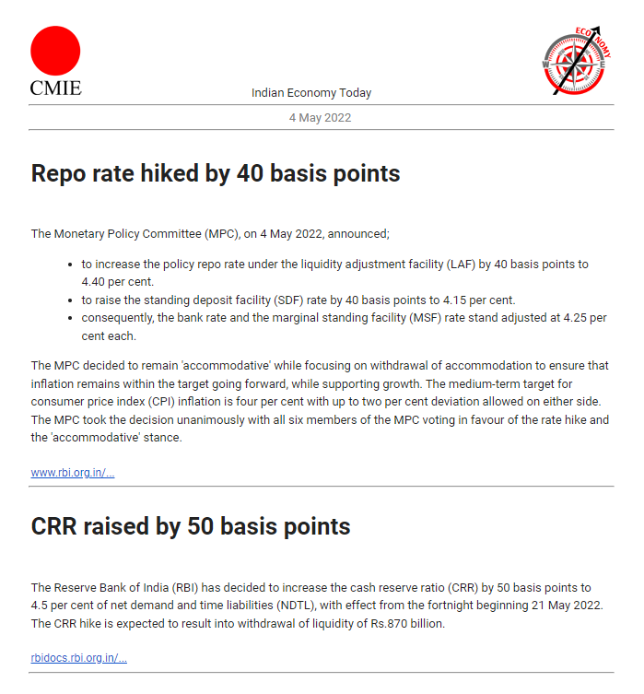

Slide 14
10. Society faces a short-run trade-off between inflation and unemployment
High inflation and low unemployment [Phillips Curve]
Higher money supply leads to higher demand
Higher demand leads to higher prices
Firms hire more workers to produce goods and services – lower unemployment
Policy makers face the trade-off (recall the first principle)

Slide 15
